Slide 1

Real-time Monitoring of Construction Noise Using Smartphones as IoT Sensors
By:
Ali Zargham, Omar Aldohami
Images obtained from https://www.edding.com/fileadmin/_processed_/c/b/csm_PR019-standard-construction-safety_843b927ee9.jpg

Slide 2


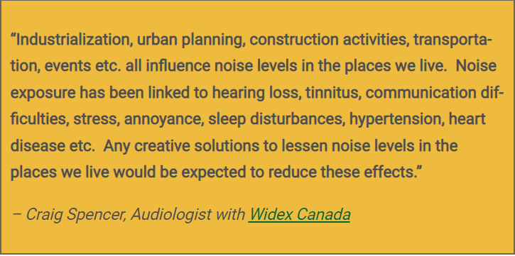
Design Driven Project 2021. Topic B IOT
Real-time Monitoring of Construction Noise Using Smartphones as IoT Sensors
Problem Statement:
A regular 8-hour exposures to 85 dBA can damage hearing
According to German research institute IFA a daily noise exposure level of 85 dB(A) or greater or a peak sound pressure level of 137 dB(C)
According to HSE, actions to be taken to reduce noise exposure with a planned programme of noise control
Data taken from https://www.hse.gov.uk/construction/healthrisks/physical-ill-health-risks/assessing-noise.htm, https://www.dguv.de/ifa/fachinfos/laerm/rechtliche-vorgaben-zu-arbeitsplatzlaerm/index.jsp images are taken from https://www.planradar.com/wp-content/uploads/2019/09/iStock-1135793300.jpg https://www.epd.gov.hk/epd/sites/default/files/epd/english/environmentinhk/noise/guide_ref/Dealing%20with%20Noise%20Nuisance.pdf

Slide 3

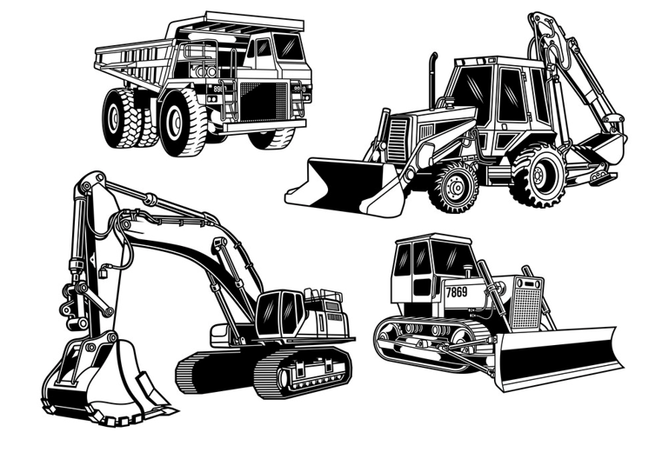
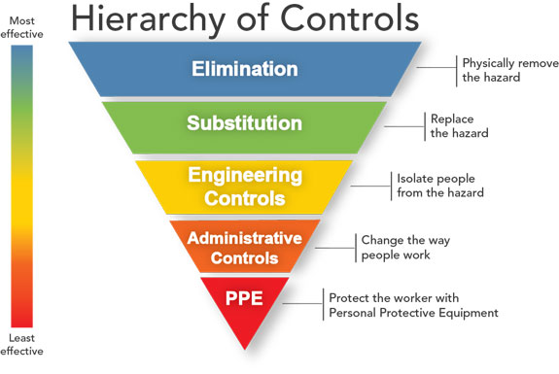
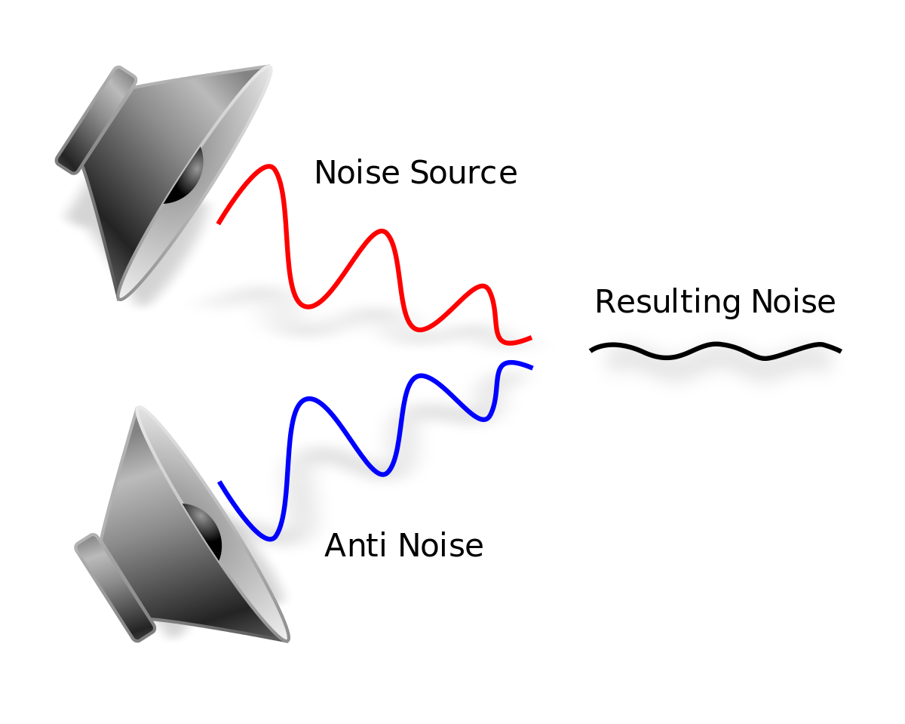
Design Driven Project 2021. Topic B IOT
Real-time Monitoring of Construction Noise Using Smartphones as IoT Sensors.
Scientific Research:
Pyramid of control:
Elimination of noise source
Noise cancellation
Images obtained from https://www.cdc.gov/niosh/topics/hierarchy/images/HierarchyControls.jpg?_=77374, https://www.vectorstock.com/royalty-free-vector/construction-equipment-collection-vector-28025933 https://en.wikipedia.org/wiki/Active_noise_control

Slide 4

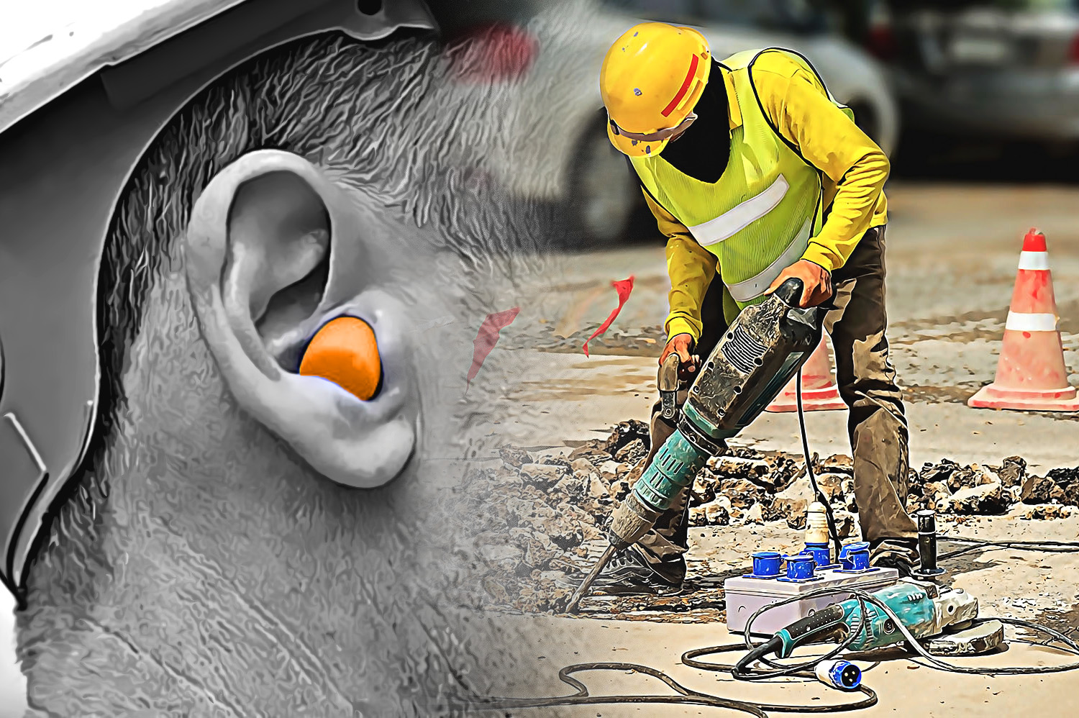
Design Driven Project 2021. Topic B IOT
Real-time Monitoring of Construction Noise Using Smartphones as IoT Sensors.
Scientific Research: Personal Protective Equipment (PPE)
Personal protective equipment for noise at construction site:
Ear Muffs
Ear Plugs
Canal caps
Image is taken from https://cf.ltkcdn.net/safety/images/orig/201345-1600x1130-worker-wearing-hearing-protection.jpg / https://news.whitecap.com/wp-content/uploads/2018/07/Demo-Hammer_Earplug.jpg

Slide 5
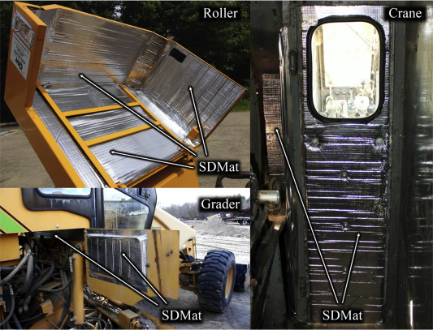
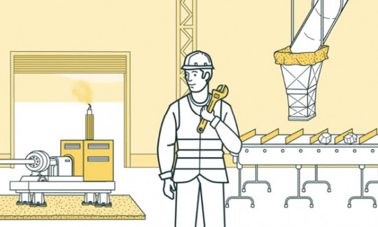
Design Driven Project 2021. Topic B IOT
Real-time Monitoring of Construction Noise Using Smartphones as IoT Sensors.
Scientific Research: Engineering Control
Engineering control is used to muffle the equipment’s so that the noise can be reduced
Noisy parts of the machines can be replaced with newer, quieter one’s to reduce noise
Images are taken from https://ars.els-cdn.com/content/image/1-s2.0-S2093791116302232-gr2.jpg

Slide 6


Design Driven Project 2021. Topic B IOT
Real-time Monitoring of Construction Noise Using Smartphones as IoT Sensors.
Scientific Research: Administrative control
Administrative control are basically the management decisions on the activities to be performed during construction:
Work rotations
Work timings
Work policies and other rules
Work practices such as standard operating procedures (SOPs)
Images are taken from https://www.trainingexpress.org.uk/wp-content/uploads/2020/09/Site-Management.jpg https://rooflinesaluminiumconcept.com.ng/wp-content/uploads/2021/09/WhyBrunspak-2-1.jpg

Slide 7
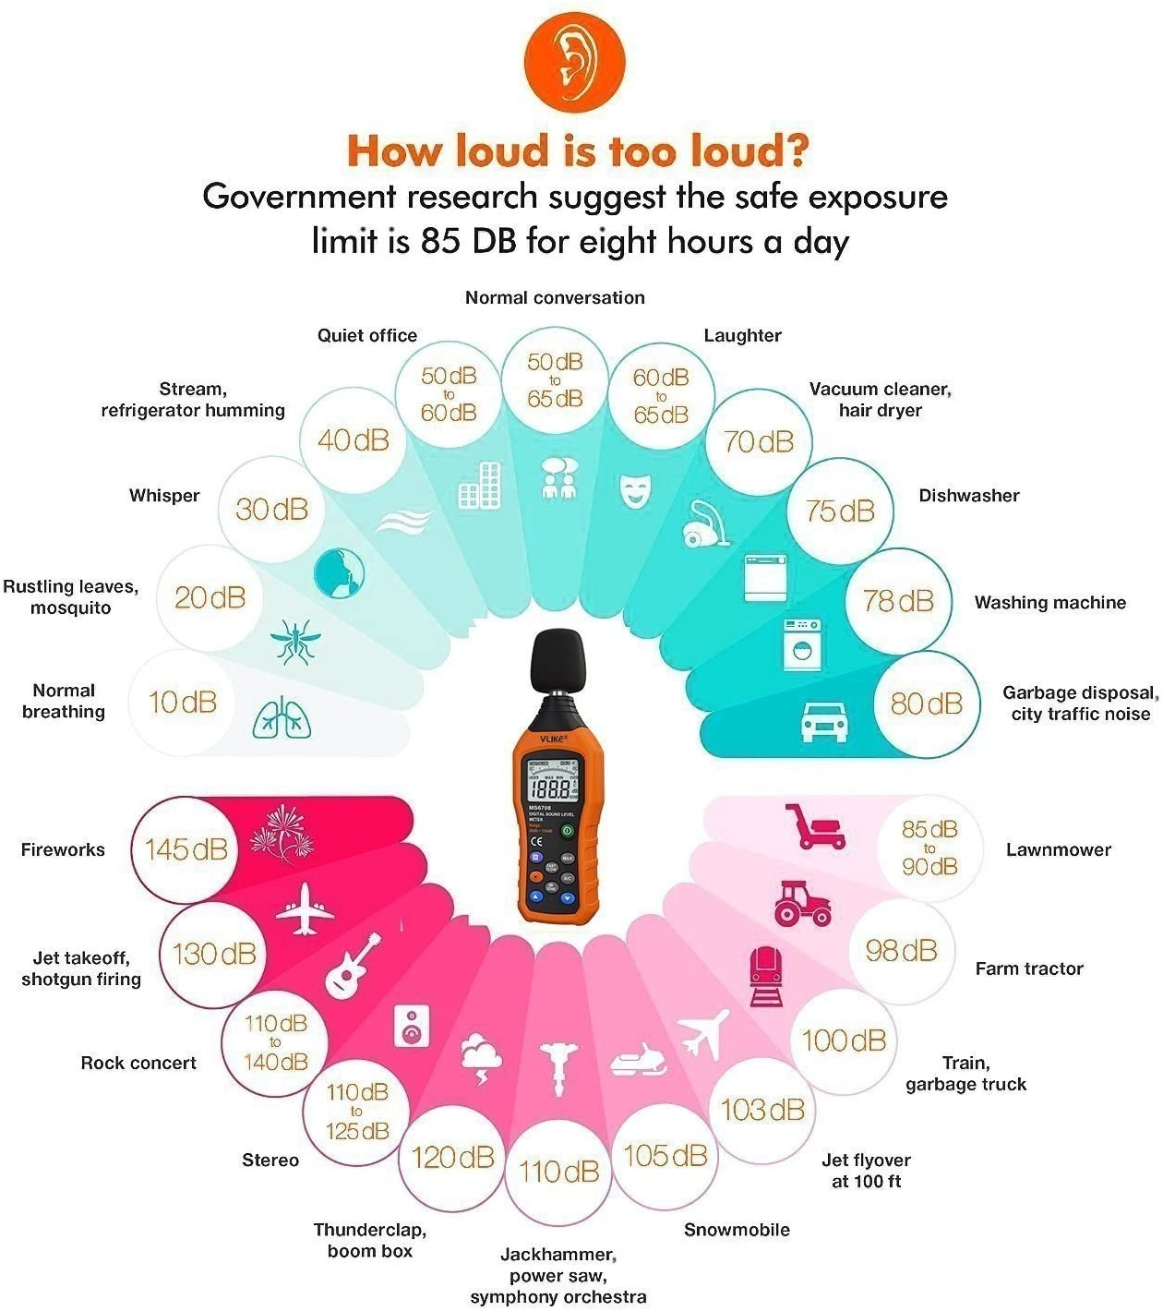
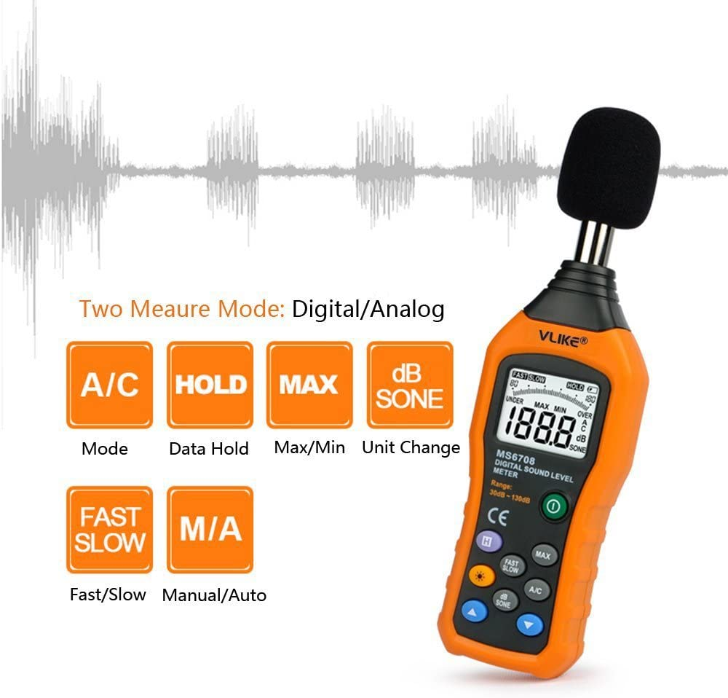
Design Driven Project 2021
Real-time Monitoring of Construction Noise Using Smartphones as IoT Sensors
Market research: VLIKE LCD Digital Audio Decibel Sound
Level Meter
The sound level meter is an instrument used to measure the ambient sound level
It costs 50,37 euros on amazon
It has measuring scope from 30 to 130dB
Limitations:
Data cannot be streamed online.
Requires someone to move it from one place to another
images are taken from https://m.media-amazon.com/images/I/71l9NvhWc+L._AC_SL1500_.jpg, https://m.media-amazon.com/images/I/61issiIUauL._AC_SL1000_.jpg

Slide 8
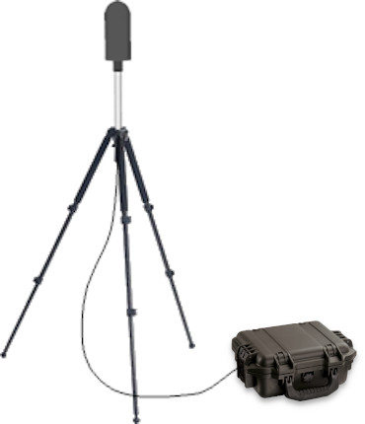
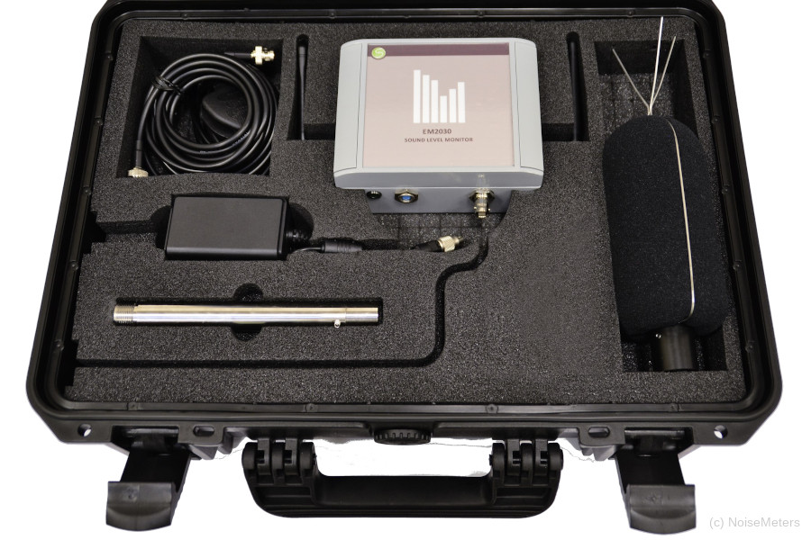
Design Driven Project 2021
Real-time Monitoring of Construction Noise Using Smartphones as IoT Sensors
Market research: EM2030P Portable Online Noise Monitor
EM2030P is a portable construction site and boundary noise monitoring meter by Noise Meters Inc USA.
It costs around $7446 with a year warranty.
The noise monitor has a battery which can last up to 10 days.
Limitations:
Very expensive product.
Requires someone to move it from one place to another
It has limited battery
Images are taken from https://www.noisemeters.com/product/sonitus/em2030p/images/em2030-inside-zoom.jpg data is taken from https://www.noisemeters.com/product/sonitus/em2030p/

Slide 9

Image is taken from https://www.toolshero.com/wp-content/uploads/2018/01/what-if-analysis-scenario-analysis-toolshero-1.jpg.webp

Slide 10

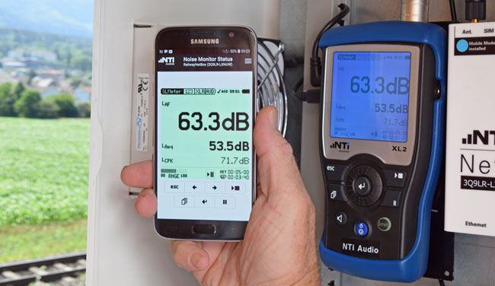

Design Driven Project 2021
Real-time Monitoring of Construction Noise Using Smartphones as IoT Sensors
Approach:
Noise Monitoring App Versions:
Construction Worker
Civilians
Image obtained from https://focusedcollection.com/258979612/stock-photo-smiling-man-sitting-sofa-using.html https://www.planradar.com/gb/field-app/ https://www.nti-audio.com/en/applications/noise-measurement/unattended-monitoring

Slide 11

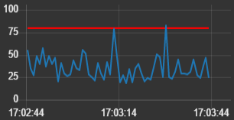

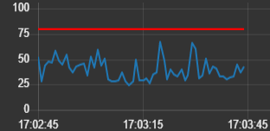
Design Driven Project 2021
Real-time Monitoring of Construction Noise Using Smartphones as IoT Sensors
Approach:
Correlation between construction and neighbourhood ?
Images are obtained from https://de.depositphotos.com/vector-images/cartoon-living-room.html

Slide 12
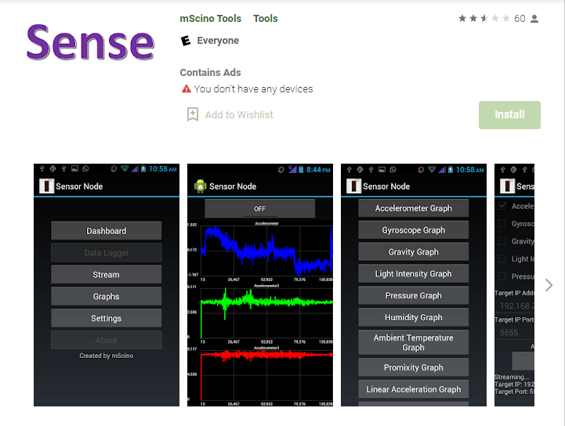
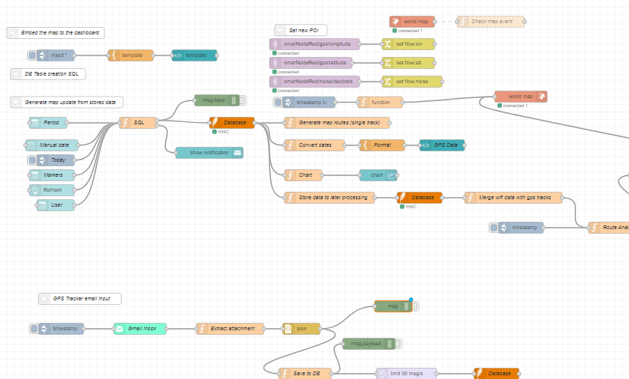
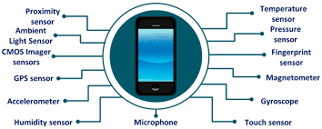
Design Driven Project 2021
Real-time Monitoring of Construction Noise Using Smartphones as IoT Sensors
Prototype:
Sensor Applications
Node-Red
Images are obtained from https://play.google.com/store/apps/details?id=com.mscino.sensornode&hl=en&gl=US

Slide 13
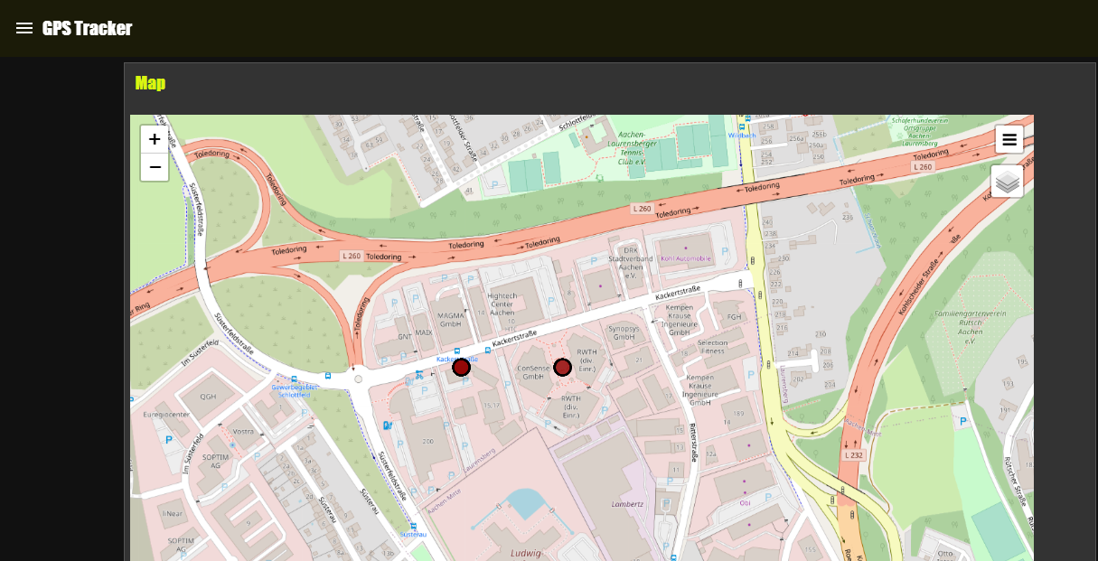
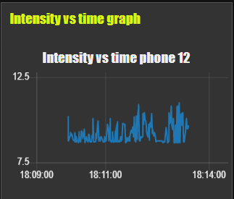
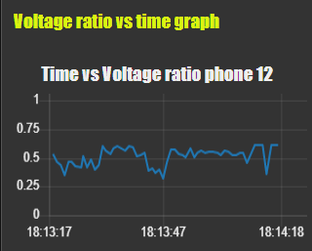
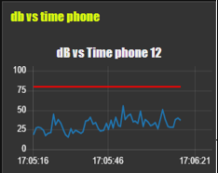
Design Driven Project 2021
Real-time Monitoring of Construction Noise Using Smartphones as IoT Sensors
Prototype:
Features
Graphs
Map

Slide 14
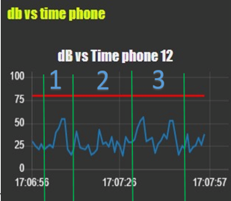
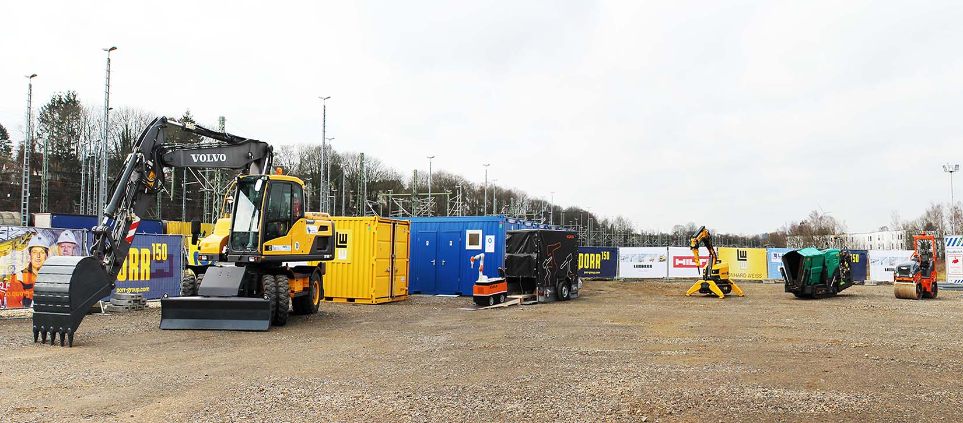
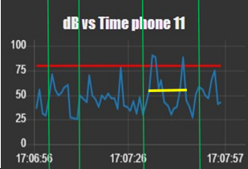
Design Driven Project 2021
Real-time Monitoring of Construction Noise Using Smartphones as IoT Sensors
Results:
Phone 12 = Inside CR classroom
Phone 11 = Near to Loader
Images are obtained from https://cr.rwth aachen.de/news/20200407_reference_site_for_cr/

Slide 15
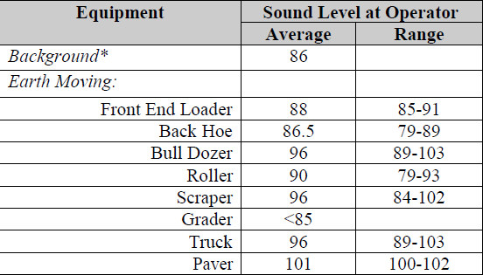

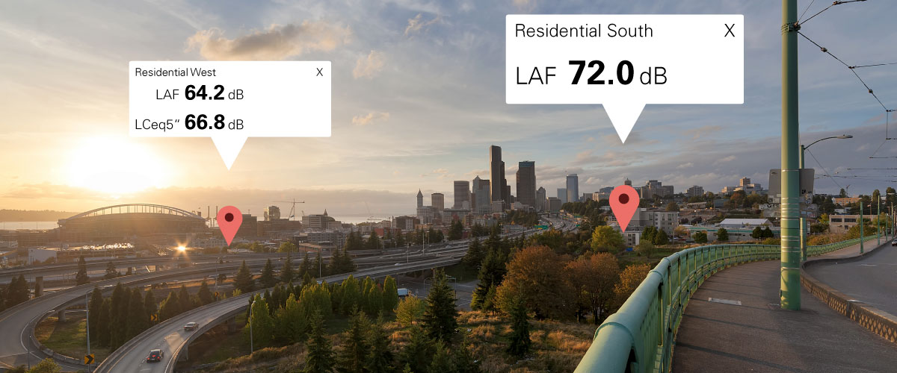
Design Driven Project 2021
Real-time Monitoring of Construction Noise Using Smartphones as IoT Sensors
Results & Conclusion:
Accuracy Approved
Numerical Means to Assist Administrative Decisions
Invest for the future!
Images are obtained from https://www.nti-audio.com/en/applications/noise-measurement/unattended-monitoring https://www.igel.com/blog/industrial-and-rugged-thin-clients-for-igel-anywhere/ https://www.lhsfna.org/LHSFNA/assets/File/bpguide%202014.pdf

Slide 16

Ali Zargham ali.kazmi@rwth-Aachen.de
Omar Aldohami omar.aldohami@rwth-Aachen.de
Image is taken from https://media.istockphoto.com/vectors/hand-holding-megaphone-vector-illustration-with-concept-message-thank-vector-id1314755983?b=1&k=20&m=1314755983&s=170667a&w=0&h=M0s9-SlAbSNBZFMQR68Dr-f81QRoGHQe8tFGbZ_pSSs=

